Slide 1

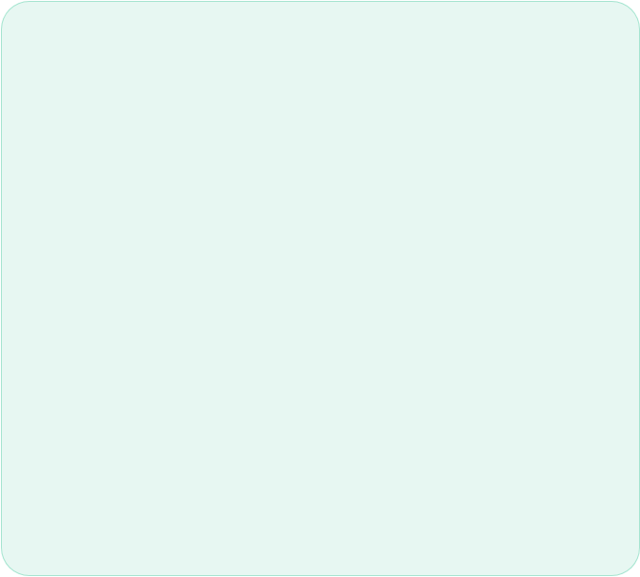
CARDSENSE
Real-Time Distributed AI Card Assistant
• Abdul Wahab
Distributed Systems Lead
• AbuBakar Amjad
App Development Lead
• Rana Muhammad Hammad Arif
Machine Learning Lead
Parallel and Distributed Computing

Slide 2

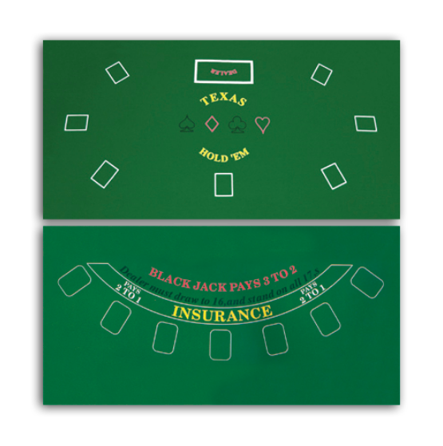

PROBLEM STATEMENT
THE CHALLENGE
In live card gameplay, players must track changing hand/table state quickly and make correct decisions under extreme time pressure.
Key Issues:
Cognitive overload for beginners.
High error rate in manual tracking.
Lack of structured assistive interpretation.

Slide 3






BACKGROUND & MOTIVATION
DYNAMIC PACE
LEARNING CURVE
VISION INTELLIGENCE
Card games are fast and visually dynamic. Manual tracking is error-prone and mentally heavy for most players.
New players need real-time learning support to build confidence and improve their decision quality during play.
CardSense converts camera frames into actionable state intelligence and real-time gameplay guidance.

Slide 4






TEAM ROLES & RESPONSIBILITIES
WAHAB
HAMMAD
ABU BAKAR
DS & Backend
Distributed API design, Redis orchestration, state reducers, and deployment topology.
ML & Worker
YOLO inference integration, model artifact handling, and vision worker pipelines.
App & Frontend
Dashboard flows, camera ingest UX, and WebSocket live feedback integration.
Shared integration responsibilities were maintained across all system boundaries.

Slide 5
SYSTEM STACK
Layer | Technologies Used | Primary Purpose
Backend | Python 3.11, FastAPI, Uvicorn | Core Logic & API Gateway
Distributed | Redis 7.4 (Streams + Consumer Groups) | Async Messaging & Scalability
Inference | YOLO, PyTorch, OpenCV | Real-time Object Detection
Persistence | PostgreSQL 16, SQLite | Game Event & Result Durability
Operations | Docker, Nginx, Prometheus | Deployment & Observability

Slide 6

PROJECT JUSTIFICATION
03
WORKFLOW FOCUS
CORE VALUE PILLARS
Technical Depth: Combines CV inference with stateful distributed logic.
Primary focus on Blackjack strategy automation, with extensibility for Thulla/Trick-taking pipelines.
Practical Relevance: Solves real-time assistance in complex environments.
Reduces cognitive load and provides reliable system-driven state interpretation.
Educational Value: Production-style architecture with horizontal scalability.

Slide 7





COURSE CONCEPTS MAPPING
1. Service Architecture
2. Async Messaging
3. Scalability
Independent services (API, Worker, Redis) communicating via networked interfaces in Docker containers.
Redis Streams decouple frame ingestion from heavy model inference for better responsiveness.
Horizontal scalability through worker replicas and multi-process consumer groups.
4. Coordination & Consistency
5. Fault Tolerance
Per-game locking (SET NX EX) and timestamp deduplication to protect shared game state.
Redis buffering prevents data loss, while health/metrics provide pipeline observability.

Slide 8

SYSTEM ARCHITECTURE
API-Service: Ingest & WebSockets.
Worker-Service: Inference Pool.
Redis: Distributed Backbone.
Database: Event Persistence.
Frontend: Live Dashboard UI.
Camera Clients API Redis (Frames) Worker Pool Reducer UI

Slide 9
OPERATIONAL WORKFLOW
INGEST
QUEUE
INFERENCE
REDUCE
BROADCAST
Clients send frames to /api/frames endpoint.
API enqueues job to Redis stream 'frames'.
Workers detect cards & publish to 'detections'.
Logic fuses detections into game state updates.
Results broadcast via WebSocket to Dashboard.

Slide 10
FUTURE ROADMAP
Model Robustness: Enhance lighting & occlusion handling.
Personalization: Add user-specific recommendation profiles.
Expansion: Support for Poker and variant card games.
Automation: CI/CD performance regression checks.
Explainability: UI tooltips explaining "Why" each move is recommended.

Slide 11


SYSTEM DEMO
Real-Time Card Intelligence in Action

Slide 12
THANK YOU
Any Questions?

